Slide 1
Initiation Tips & Tricks
Advisor Meet Up
January 25, 2024

Slide 2
Agenda
Introductions
What is Initiation and why is it important?
National Virtual Initiations
Handbook
Planning List
Share: Tell us about your initiation!

Slide 3
What Is Initiation & Why Does It Matter?
Initiation is a formal, special event for new members and their invited guests.
It’s also a chance to recognize outgoing members.
Though each chapter customizes initiation, the core parts of the ceremony remain the same for all members.
Initiation is a Mortar Board tradition over 105 years old!
Ideally, initiations are in person. If capacity, resources, or timing is an issue, we have National Virtual Initiations.

Slide 4
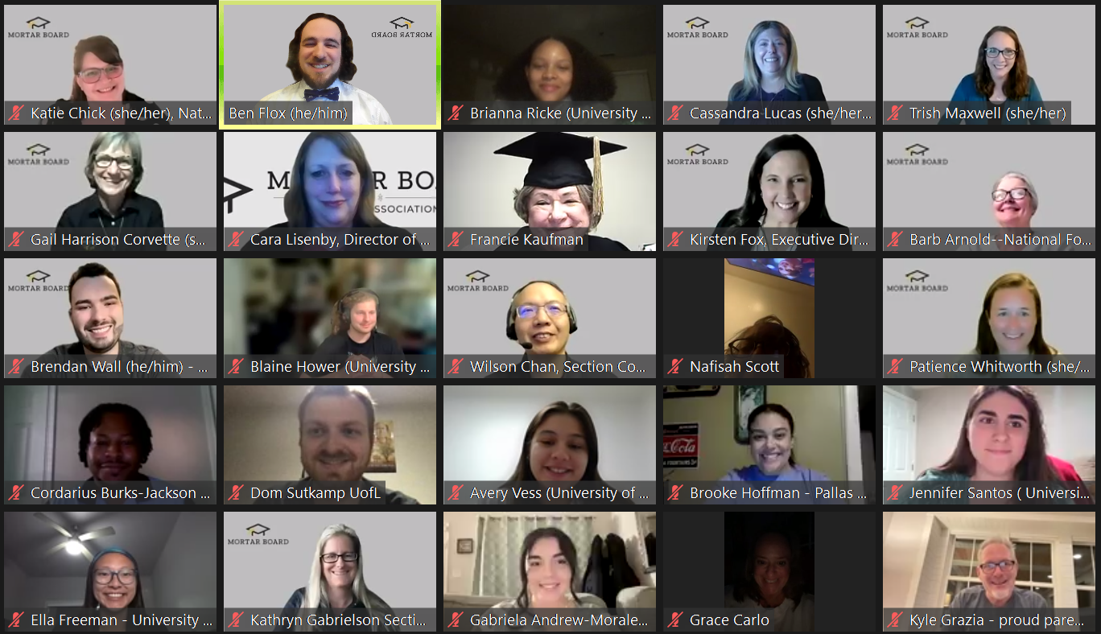
National Virtual Initiations
Hosted by Mortar Board’s National President
Great option for chapters struggling to hold an initiation on campus
Typically get 5-10 chapters per initiation; students are all initiated together
Guests and chapters members encouraged
Sunday, April 14, 2024 8pm ET / 7pm CT / 6pm MT / 5pm PT / 2pm HT
Sunday, May 19, 2024 8pm ET / 7pm CT / 6pm MT / 5pm PT / 2pm HT

Slide 5
Initiation Handbook
Contains:
Initiation Preparation
Initiation Ceremony Script
The Torch poem
Stage Diagram
Mortar Board sheet music
Mortarboard.org/resources
“Handbooks & Guides”

Slide 6
Planning
Participants
Attire
Campus speaker
Alumni / National Leaders?
Officers & Advisors
Current members
New members
Invited guests
Some chapters use academic regalia and black graduation gowns
Some chapter have incoming members in white and outgoing in black
Some chapters opt for business-casual attire

Slide 7
Planning
Regalia & Program
Mortar Board Pieces
Flowers or centerpieces
Ribbons with pins fastened
Certificates
Silver candlesticks; gold candles
Chapter roll book & pen
Printed program with schedule and names
Music (sheet or recording)
The Torch
The poem read during initiations and formal events
Mortar Board Ode (start)
https://youtu.be/GlAx9z1Xxak?si=I61xSYBRcniOls5w
Thy Ideals (end)
https://youtu.be/S1EFvR7qQWI?si=8JfC2b_uXiAef63w

Slide 8
What do you do? Share your chapter’s initiation tips and tricks

