Slide 1
Spring Recruitment
November 2023

Slide 2
Agenda
Introductions
Recruitment vs. Selection
Recruitment & Selection Timeline
Best Practices we’ve seen
Share: What have you done?

Slide 3
What’s the difference?
Recruitment
Promoting chapter visibility
Obtaining the eligibility list
Applications
Selection
Reviewing applications
Selecting new candidates

Slide 4
Recruitment & Selection Timeline
Recruitment
Selection
Obtain eligibility list from Registrar (4-6 weeks before selection, depending on campus)
Ask for nominations from faculty, staff and students
Send applications to eligible students (at least 2 weeks before selection)
If the chapter typically struggles with recruitment, build in an extra week for a deadline extension
Send reminder email (1-2 days before app deadline)
Selection
Selection: choose candidates from applications (2-3 weeks before initiation)
Submit Candidate Request to the National Office (2-3 weeks before initiation)
Public Tapping of your members to notify them of membership (2 weeks before initiation)
Hold an orientation/info session (1 week prior to initiation)
Initiation
Pro Tip: Allow 6-8 weeks from start to finish for best results.

Slide 5
Sample Timeline
Task | Date
Request eligibility list | Mid-End of December; Early January
Send application email | January 15
Send reminder email | January 29
Application deadline | January 31
Hold Selection Meeting | February 5
Submit Candidate Request | February 9
Public Tapping: Mortar Board Week | February 11-17
Orientation | February 20
Initiation | February 25

Slide 6
Recruitment
Eligibility list is crucial
Not a FERPA violation; you’re asking for directory information (name, emails)
We don’t need GPA; just to know they meet eligibility requirements
Start recruitment in the Fall – now is a great time!
Involvement fairs, tabling, t-shirts, campus events (i.e.: chapter visibility)
Partner with student groups and campus offices to spread the word about Mortar Board
Consider involving DEI professional for best practices in inclusivity
Have each current members reach out to 3-5 student organizations to help recruit

Slide 7
Application
Things You Need:
Things to Consider:
Name
Primary Email (campus)
Secondary Email
Phone
Home Address
Graduation Date
Confirmation of academic eligibility (Top 35% or 3.0+ GPA; junior by credit hour)
Evidence of leadership & service
Ask only what you plan to use for selection and/or a bio
Keep the length of the application reasonable
Consider tapping method: i.e.: do you need to ask for schedules?
Letters of recommendation v. reference name/email
What else does your chapter ask?

Slide 8
Selection
Consider the numbers:
Example:
What’s your average size? Has it fluctuated in the last few years?
Are you looking to grow your chapter? If so, by how much?
What’s your average yield? Consider yield when selecting class size (National Office has this info)
Three-Year Average:
Chapter Goal: 40 members
Selection Goal: 60 members
The National Office is happy to help you figure this out!
Year | Candidates | Members | Yield
2023 | 41 | 29 | 71%
2022 | 43 | 30 | 70%
2021 | 51 | 37 | 73%

Slide 9
Qualities of a good Mortar Board
Scholarship
Leadership
Consider roles and actions, not just positions
Quality vs. quantity
Employment, athletics, military
Service
Community service
Service to alma mater
Equity
How do they promote equity?
What does your chapter look for?

Slide 10
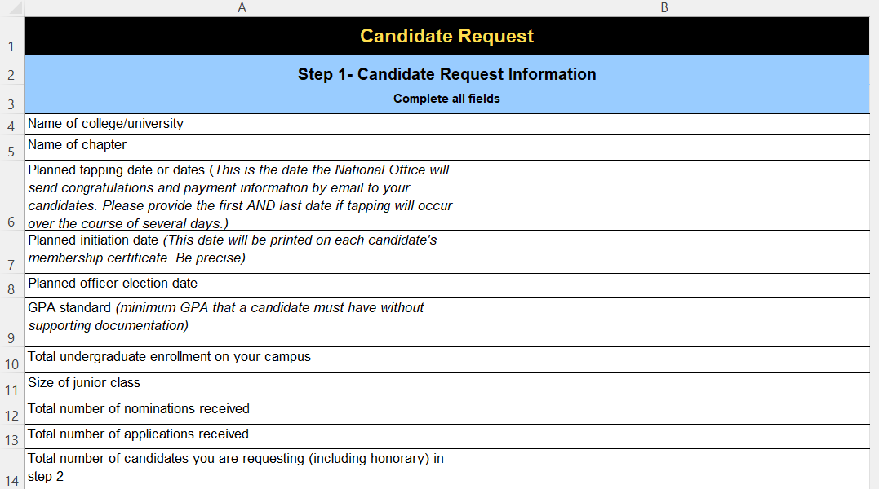
Submitting the Candidate Request
Ideally submitted at least 2 weeks prior to tapping & initiation
Complete:
Tab 1: Candidate Request Info
Dates, size, contact, mailing, dues
Tab 2: Candidate Information
Names, phone, emails, address, grad, GPA
If you know continuing seniors & gift members, add to Tab 4
Post Initiation:
Tab 3: Who accepted
Tab 4: Confirm gift & continuing seniors

