Slide 1
Membership Information Session 2024

Slide 2
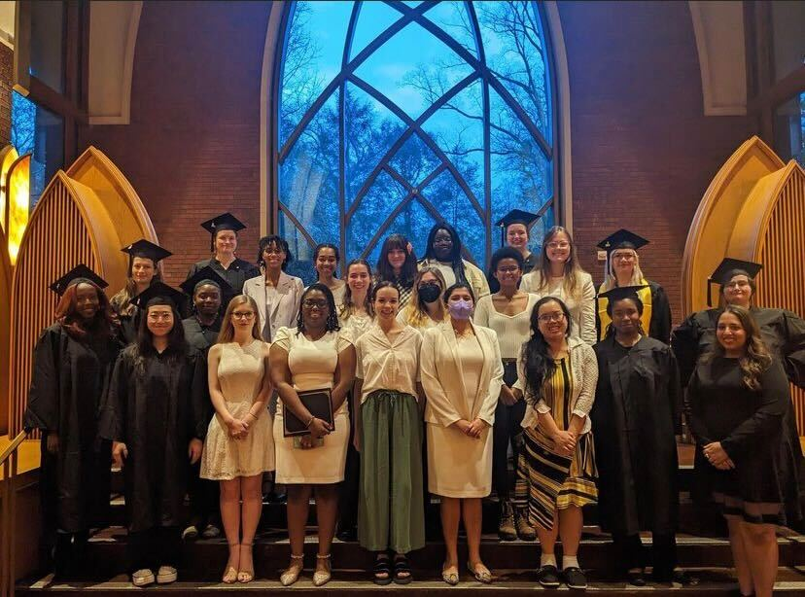
Agenda
Welcome / Introduction
What Is Mortar Board?
Brief History
Member Benefits
Time Commitment
Chapter Activities
Leadership Opportunities
Alumni Network

Slide 3
What Is Mortar Board?
Mortar Board, Inc. is a national honor society that recognizes seniors for their achievement in scholarship, leadership and service, provides opportunities for continued leadership development, promotes service to colleges and universities, and encourages lifelong contributions to the global community.
Chartered on 235 campuses, Mortar Board has over 300,000 Alumni members across the country.

Slide 4
Mortar Board’s Guiding Principles
Motto – Pi Sigma Alpha, letters that correspond to three Greek words representing the Ideals of Mortar Board: scholarship, service and leadership.
Symbol – A mortarboard, an ancient symbol of honor and distinction, represents the organization.
Colors – Gold (representing achievement) and silver (symbolizing opportunity).

Slide 5
Brief History
1915 – Members from all-women honor societies at Ohio State and Swarthmore meet by chance.
February 15, 1918 – Founding meeting at Syracuse University. Cornell University, The Ohio State University, The University of Michigan and Swarthmore College attended.
1919 – Mortar Board became the official name at the second national convention.
1937 – Mortar Board was invited to become a member of the Association of College Honor Societies (ACHS) as the only organization composed entirely of women. (Mortar Board is still a member 80+ years later!)

Slide 6
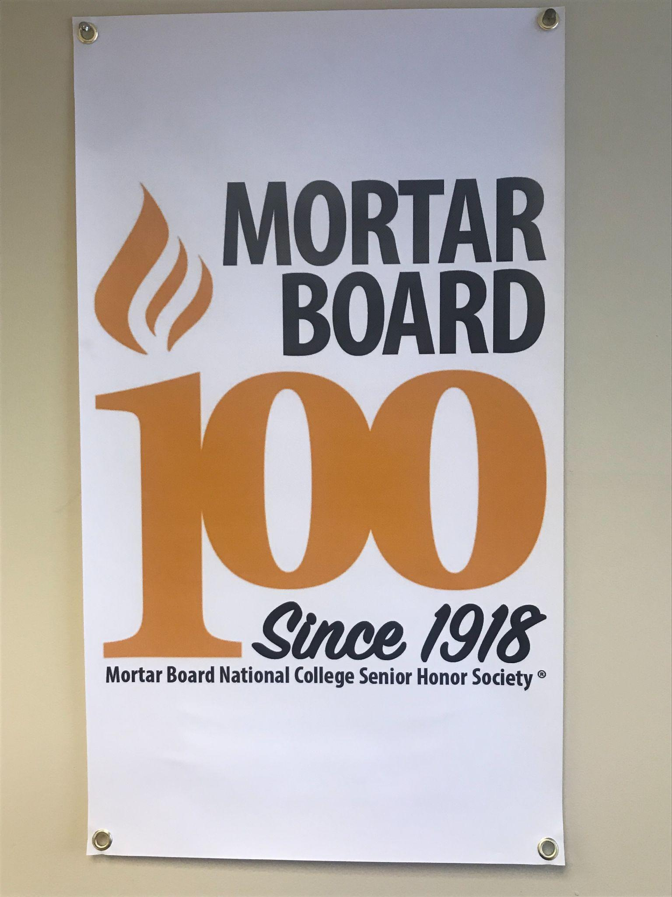
Brief History
1943 - The first African American woman was initiated at The Ohio State University.
1955 – Delegates voted to establish the Mortar Board Foundation Fund as a means for contributions to advance the purpose.
1975 – Mortar Board voted to include men.
2002 - “Reading is Leading” was adopted as the permanent national project.
2012 - The Mortar Board Alumni Association was established.
2018 - Mortar Board celebrated its centennial birthday!

Slide 7
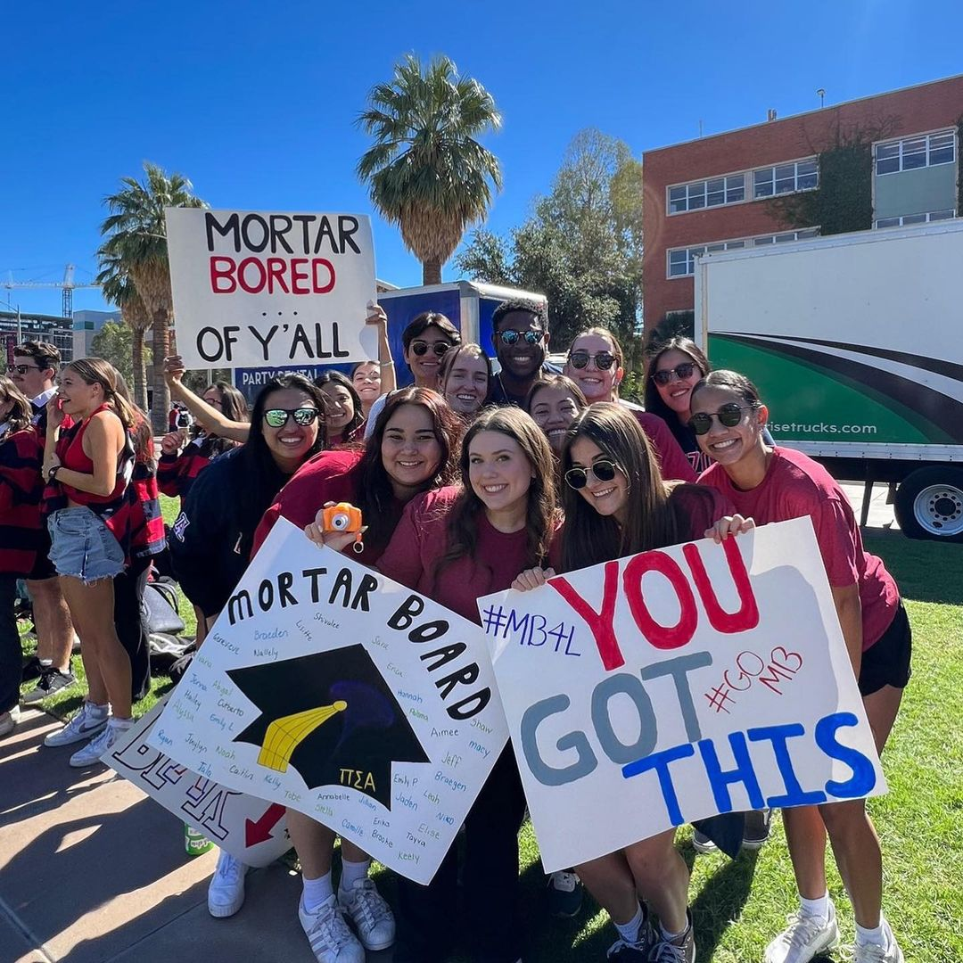
Mortar Board Today
235 chapters across the country
Program around the tenets: scholarship, leadership, service
Commitment to Diversity, Equity, Inclusion & Belonging
106 years later and Mortar Board is still student-governed

Slide 8
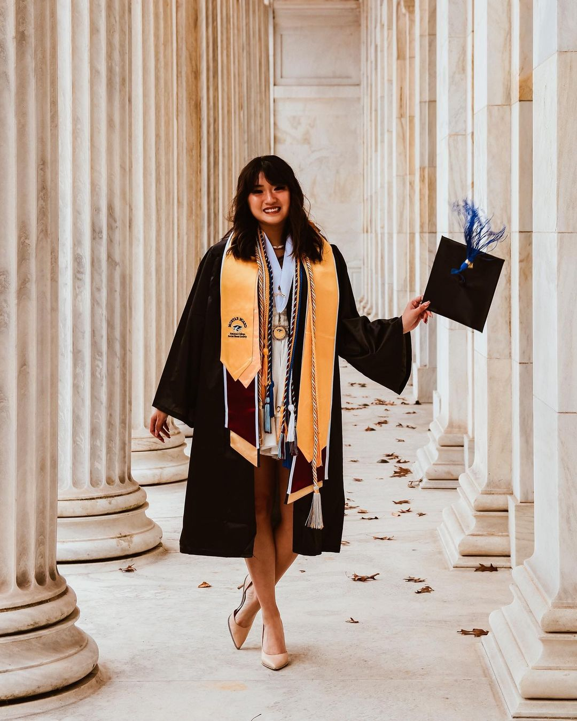
Member Benefits
Mortar Board’s greatest asset: OUR MEMBERS
Active alumni network across the country
Lifetime membership
Career Connections - NEW career development series
Graduation regalia to show your accomplishment
Fellowship Program for graduate studies
National Programming on leadership and professional development
Recognition as a top leader on your campus
National Partnerships like Kaplan (test-prep) and Oasis (mental health)
Federal jobs pay increase - being a member starts you at a GS-7, two salary levels higher than your peers!

Slide 9
Time Commitment
General Member
1-2 hours per month
Chapter Officer
1-2 hours per week
National Committee (Governance, Nominations, DEI, Conference)
2-3 hours per week (including chapter leadership)

Slide 10
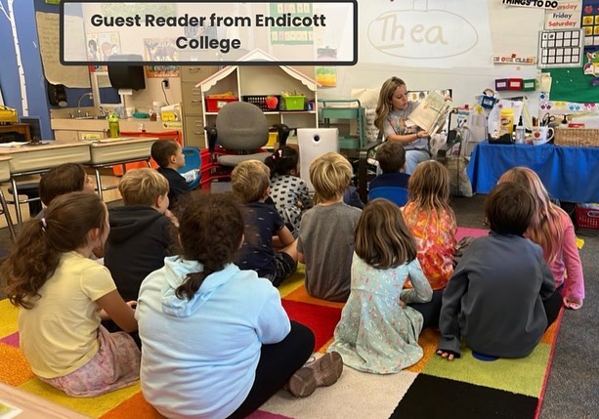
Chapter Activities
Academic support and career- development programming
“Reading is Leading” service projects like tutoring, book fairs, and reading
Campus engagement and partnerships
Fundraising for your chapter and the local community
Recruiting, selecting, and tapping the new class of Mortar Boards

Slide 11
Leadership Opportunities
Serve as a chapter officer in your senior year
Stay involved in your school as an active alumni member
Serve on a national committee or advisory board, like the Conference Advisor Board or Alumni Advisory Board
Serve in a national leadership role such as a Section Coordinator, Student or Alumni Representative, or a member of the National Council (Board of Directors)

Slide 12
Alumni Network
Stay involved after graduation and connect with the alumni network of over 300,000!
Join the Mortar Board Alumni Association (MBAA) to meet other alumni near you and across the country.
Participate in book clubs, write for Mortar Board publications, volunteer at local Mortar Board events, or financially support new Mortar Boards

Slide 13
Follow Mortar Board on Social Media!
Company: Mortar Board
National College Senior Honor Society
@mortar_board
@MortarBoard
@nationalmortarboard9991

Slide 14
Questions?
Contact chapters@mortarboard.org or call 614-488-4094

