Slide 1
Mortar Board
End of Year Wrap Up
April 2024

Slide 2
Agenda
Introductions
Chapter Annual Report
Collegiate Award
Advisor Report
Official Membership Report / Chapter Annual Fee
Mortar Board National Conference

Slide 3
Chapter Annual Report
Due May 15
(June 1 for quarter schools not applying for awards)

Slide 4
Why it matters
Provides institutional record to national office
Creates best practices for all chapters to use
Transitions new officers (and advisors, if applicable)
Gives valuable insight to impact national operations
Allows national office to best understand chapter health, how we can help, what resources to develop, etc.

Slide 5
Sections
Incoming Chapter Officers (2024-2025)
Incoming Advisor Information (2024-2025)
Chapter Goals & Advice for Future Leaders
Tapping and Initiation History
Region Coordinator & National Office
Chapter Events & Programs
Chapter Health
Conference Information
Chapter Finances
Chapter Historian Report
Collegiate Awards

Slide 6
Collegiate Awards
Due May 15

Slide 7
Collegiate Awards
On the Chapter Annual Report
Separate Applications
Gold Torch
DEI&B Awards
Project Excellence
Outstanding Achievement
Ruth Weimer Mount Chapter Excellence
Freeman & Fox Most Improved Chapter
Excellence in Advising
Starlington Prize

Slide 8
On the Chapter Annual Report…
Gold Torch
DEI&B Award
Honors chapters that exemplify scholarship, leadership and service. These chapters are active on their campus in ways that improve the quality of student life.
Recognizes outstanding efforts/successes by chapters on projects and initiatives that focus on the tenets of diversity, equity, and inclusion with an outcome of belonging.

Slide 9
On the Chapter Annual Report…
Project Excellence
Outstanding Achievement
Recognize outstanding chapter projects:
Scholarship
Leadership
Service
Fundraising
Alumni involvement
Reading is Leading
Mortar Board Week
Recognize outstanding progress in areas such as:
Recruitment & Selection
Advisor Transition
On-Campus Visibility
Social Media & Digital Outreach
Chapter Reinvigoration
Chapter Communication
Alumni Programming

Slide 10
Separate Applications…
Ruth Weimer Mount
Chapter Excellence
Freeman & Fox
Most Improved Chapter
Highest honor given to any chapter. This award is given to the chapter who demonstrated excellence in chapter operations, advising, visibility, communications and participation.
This funded award supports chapters who are developing their programming and increasing their presence on campus.

Slide 11
Separate Applications…
Excellence in Advising
Starlington Prize
Demonstrated a commitment to the purpose of Mortar Board and who have gone above and beyond in their work with a collegiate chapter.
Extraordinary members who embody Mortar Board’s purpose, are dedicated to their chapter and who are obligated to their membership in the Society.

Slide 12
Advisor Report
Due June 1

Slide 13
Why it matters
Provides record to national office
Send letter of service to up to three campus official
Transitions new advisors, help remember last year
Gives valuable insight to impact national operations
Allows national office to best understand chapter health, how we can help, what resources to develop, etc.

Slide 14
Sections
Chapter Goals & Advice for Future Leaders
Region Coordinators & National Office Support
Chapter Health
Conference Information
Letter to your supervisor

Slide 15
Official Membership Report & Chapter Annual Fee
Due 21 days after initiation

Slide 16
Official Membership Report & Chapter Annual Fee ($350)
Official Membership Report
Official payment roster of new members
Continuing students listed
Sent by national office to new leaders late summer
Chapter Annual Fee ($350)
Covers one student delegate to attend conference (hotel, meals, materials for 2 nights)
Support chapter operations and development

Slide 17
Mortar Board
National Conference
Friday, July 26 – Sunday, July 28
Columbus, OH

Slide 18
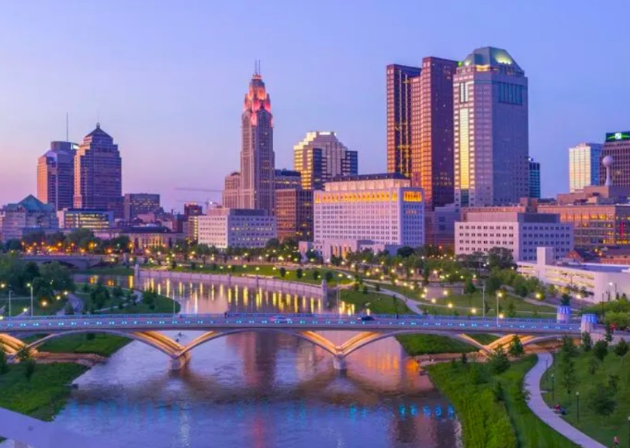
mortarboard.org/ conference
Friday, July 26 – Sunday, July 28
Columbus, OH
Registration is open!
One student delegate required per chapter; more welcome!
Advisor Track available this year (with advisor grants, if needed)

