Slide 1
Chapter Success: Engagement & The Mortar Board Experience
March 2025

Slide 2
Agenda
Introductions
Name, Institution, Role, Years with Mortar Board
Chapter Excellence = The Mortar Board Experience
Administrative Excellence
Membership Excellence
Programming & Engagement Excellence
Discussion

Slide 3
The Mortar Board Experience

Slide 4

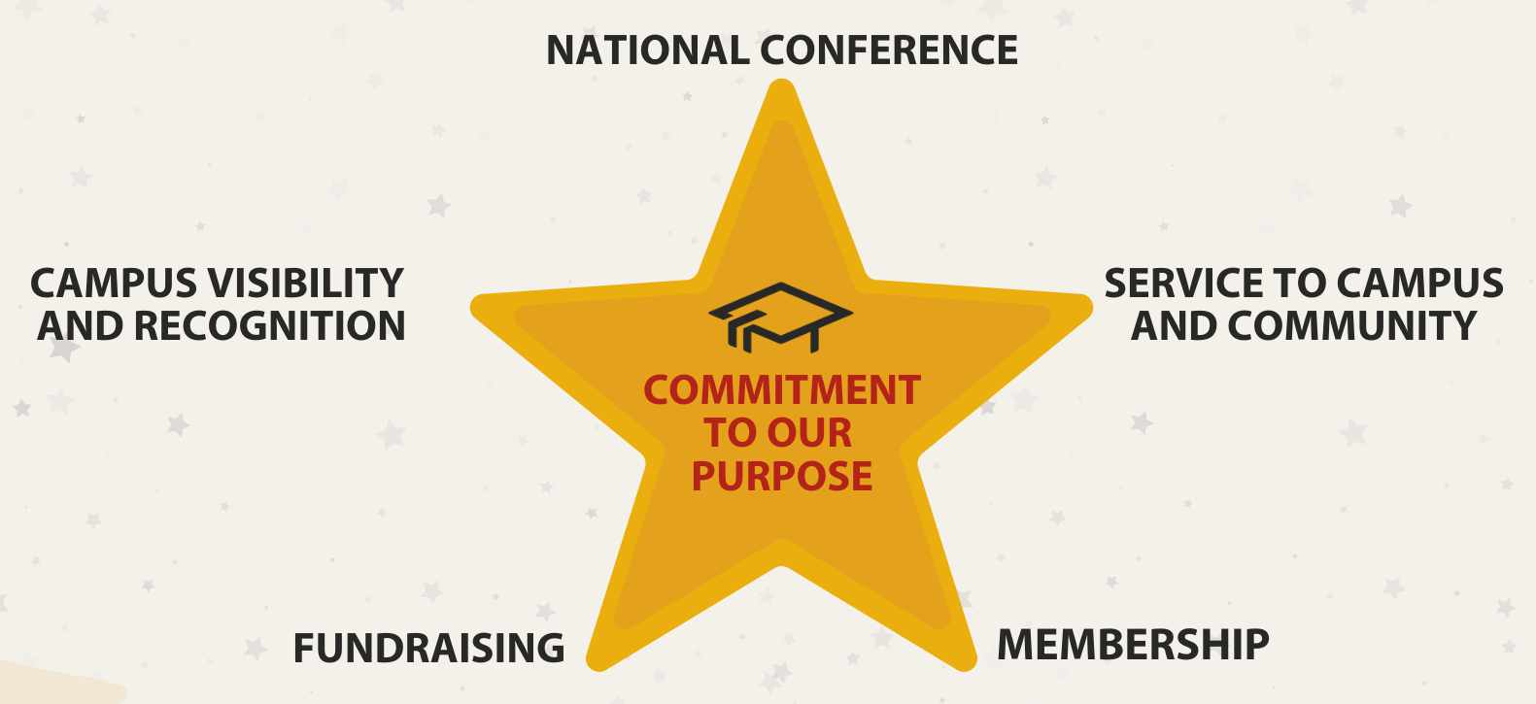
The Mortar Board Experience A shared experience for all collegiate members

Slide 5
Administrative Excellence

Slide 6
Key Chapter Items / Deadlines
National Conference – July 19 & 20, 2025 (virtual)
Chapter Action Plans – due September 30
Special National Conference – January 2026
Selection – spring, could add a fall
Chapter Annual Reports & Awards – due May 15

Slide 7
Strong Chapters:
Have at least two advisors
Have multiple executive board members
Have a plan for transitioning officers (meetings, guides)
Send out meeting times in advance, for planning
Ask students when they can meet!
Engage chapter members in planning & events
People support what they help create
Communicate with the National Office

Slide 8
Membership Excellence

Slide 9
Timeline: Getting to Selection
Chapter Visibility – all year, specifically in fall
Get applications out early – before February
Applications due early/mid Spring
Give students 2-4 weeks to complete
Build in a few days for extension (if needed)
Selection – shortly after application deadline

Slide 10
Timeline: Welcoming New Members
Tapping – after list approved by National Office
In person is key!!! – Need ideas, let us know!
Orientation – hold
Biweekly national info sessions if you want to leverage them
Initiation – make it special!!!
Try to ensure everyone has paid before initiation
Only distribute certificate and pin if paid
21 Days after Initiation = Official Membership Report Due

Slide 11
Tips for Candidate Request (CR) / Official Membership Report (OMR)
Candidate Request (pre-tapping)
Official Membership Report (post-initiation)
Tab 1 – Initiation Info
Tapping, initiation dates
Contact & shipping info
Local dues & dues collection
Tab 2 – Candidate Info
Need: Name, email, grad date, GPA
Also get: Alternate email, phone, home mailing address
Tab 3 – Gift Membership
Each chapter allowed 1
Tab 4 – Official Membership Report
Confirm paid, pending, refused
Only select refused if they said no, otherwise, pending
Invoice to follow

Slide 12
Emails the National Office Sends
To New Members
To Chapters
Welcome Email
One day after tapping
Payment Reminder email
1 week before Initiation
Post-Initiation Payment Reminder email
2 days after Initiation
Candidate Request approval
Roster Link & Pre-Initiation Information
2-3 days after Welcome
Post-Initiation Information
4-5 days after Initiation
Official Membership Report approval & invoice

Slide 13
Programmatic & Engagement Excellence

Slide 14
Fundraising
Blossom Express Flower Sales
Bake Sales or Cookie/Donut Sales
Dine-to-Dollars nights at local restaurants
Headshots & photo booths
Candy and flower sales
Mortar Board Week (and Valentine’s Day)
Administrative Professional’s Day
Finals week survival kits
Campus Partnerships - Donate 2 Dunk & Pie in the Face
Goal: Chapter and Financial Sustainability

Slide 15
Chapter Visibility Through Recognition
Faculty / Staff Recognition
Top Prof & Apple Polishing (U South Alabama, Texas Tech)
People Who Inspire (U Nebraska-Lincoln)
Thank you notes
“Top Lists” for Students & Student Scholarships
These are your future Mortar Boards!!!

Slide 16
Service
To Campus
To Community
Last Lecture Series
Campus clean-up
Volunteers at Events
Orientation
Academic Convocation
Career Fairs
Admissions Open Houses
Commencement
Reading is Leading
Book/supply drives
Tutoring
Reading to children
Other top projects we see:
Food insecurity support
Animal care
Community clean-up
Clothing & supply drives

Slide 17
Engagement
Involve members in planning and execution
People support what they help create
Enhance general meetings – consider speakers, service projects, socials, etc.
Get meeting/event dates out early
Allow students time to get on their calendar
Consider point systems to encourage engagement
Punitive measures do not increase engagement
Connect with National Reps (National Office, Region Coordinators) – general questions, chapter celebrations, troubleshoot issues, etc.

Slide 18
Discussion

