Slide 1

The Mortar Board
Experience
For collegiate members

Slide 2
A Shared Experience for all Collegiate Members
Notes:
What we’ve heard

Slide 3

Five Points of the Signature Experience
Membership
National Conference
Service
Campus Visibility through Recognition
Fundraising
Notes:
Size of institution, size of chapter — how you focus may look different but a common “signature experience” of each chapter/member within the chapter is to experience the 5 points of the star

Slide 4
Five Points of the Signature Experience
Commitment
to the
Purpose
Membership
National Conference
Service to Campus and Community
Campus Visibility through Recognition
Fundraising

Slide 5
At the core of the star:
Commitment
to the
Purpose
promote equal opportunities among all peoples,
emphasize the advancement of the status of women,
support the ideals of the college or university,
advance a spirit of scholarship,
recognize and encourage leadership,
provide service,
contribute to the self-awareness of its members, and
establish the opportunity for a meaningful exchange of ideas as individuals and as a group.

Slide 6
Exploring the Star

Slide 7
Reinvigorated Focus on Membership:
Recruitment
Selection
Tapping
Initiation
Transition
Notes:
U Hawaii: How they improved membership, Recruitment + Selection (Gabrielle)
U Nebraska, Lincoln: Tapping
Ole Miss: Initiation (Brett)
UVM: Transition

Slide 8
Visibility through Recognition
“We want to increase our chapter visibility on campus.”
Branded Program around recognition. Sample ideas: Awards and Recognition (Top Prof, Service Awards, Sophomore Awards, Last Lecture, etc.)
Notes:
Texas Tech: Apple Polishing (Dominick Casadonte)
South Alabama: Top Prof (Repeat student)
Staff Recognition: Ohio State (Julie?)

Slide 9
National Conference
National Conference
Provides a physical shared experience for members across all chapters to connect, to share knowledge, to learn, and to lead.
Notes:
In-Person: “You see what is great about conference”, was a CAB, am now an RC etc. (Kailey)
Virtual: how great virtual conference was, networks and connections, sense of belonging, created a pathway for national involvement and leadership (Tamika)

Slide 10
Chapter Financial Sustainability
Fundraising
With a sample of options: Blossoms Express, Tabling, Local Dues, etc.
Notes:
Hood College: (University of Louisville as backup): Blossoms Express (Phebe)
Wichita State: Pickleball Tournament
National Office: Some examples that she has seen. And, she is there as a resource. (Liz Cook)

Slide 11
Service to Campus and Community
Service
National Project, Service to Alma Mater, Service in Local Community
Notes:
Purdue: Nearly Naked Mile (Clothing Insecurity)
Illinois State: Reading is Leading (Bello Rohrig)
University of San Diego: Last Lecture Series

Slide 12
Five Points of the Signature Experience
Commitment
to the
Purpose
Membership
National Conference
Service to Campus and Community
Campus Visibility through Recognition
Fundraising

Slide 13
The Mortar Board Experience meets the following goals:
A member benefit and a shared member experience over time via conference.
Financial Sustainability
Best Practices for chapter membership
Staying true to our mission of service to campus and community
Increased campus visibility

Slide 14
The Mortar Board Experience meets the following goals:
Increased Capacity
We are doing much of this or need to focus on these points anyway.
Ability to meet goals and feel fulfilled
Sustainability and Campus Support
Consistent programming and operations across chapters to achieve the Mortar Board experience supports a model for chapter sustainability
Provides colleges/universities clearly defined roles and opportunities they can support.

Slide 15
Five Points of the Signature Experience
Commitment
to the
Purpose
Membership
National Programming
Awards & Recognition
National Society Governance
Mortar Board Week
National Conference
Service
Chapter Meetings
Member Benefits and Programming
Alumni Connections
National Meetings
Campus Visibility through Recognition
Fellowship Awards
Fundraising
Traditions
Notes:
All of these other items are Starbursts and still aspects of the collegiate experience that still take place each academic year.
Membership, as a reminder, includes: Recruitment, Selection, Tapping, Initiation, Orientation, Onboarding, Transition (i.e. Officer Elections)

Slide 16
National Support

Slide 17
Fundraising & Chapter Finances
Chapter Fundraiser Ideas
Chapter Finance Meetings with National Office
Shared information about chapter health

Slide 18
National Conference
2025 will be virtual – July 19 & 20
New format! Two four-hour days
Look for specific ways to engage online
Encourage more than one attendee per chapter (at no additional cost)
If you’re interested in helping plan MBNC25, let us know!

Slide 19
Service
Chapter Service Project Ideas
Chapter Reading is Leading Ideas
Leverage campus partnerships

Slide 20
Campus Visibility Through Recognition
Fall meeting with Region Coordinator to discuss ideas for chapter visibility and recognition initiatives
Goal: Each chapter does some type of recognition initiative
Chapter Recognition Project Ideas

Slide 21
Membership
Fall meeting to discuss chapter membership history, goals, and target recruitment/selection numbers
Best Practice: Initiate before Spring Break

Slide 22
Membership Timeline Explained
Recruitment in the fall
Allow at least two weeks for applications (one month is best)
Hold selection with all members participating
Submit Candidate Request to National Office at least two weeks before Tapping
Allow at least a week between tapping and initiation
Membership dues are due 21 days after initiation
Notes:
Ben

Slide 23
What’s on the Candidate Request?
Tapping and Initiation Dates
Contact information (where to send certificates)
Local Dues/Amount
Candidate Information:
Name Email (and secondary email) Graduation Date GPA / Confirm academic eligibility If you can: Phone, Home Address
Notes:
Ben

Slide 24
What the National Office Does
Processes Candidate Request and sends certificates/pins
Sends Welcome Email after tapping
Sends payment reminder emails before and after initiation (if dues paid online)
Tracks and shares payment rosters
Helps close membership roster and sends chapter invoices
Notes:
Ben

Slide 25
New Resources

Slide 26
Meetings with RC/National Office
Four Brief (15-30 min) Touch Base Meetings with RC/MBNO:
September/October: Chapter Action Plan, Visibility November/December: Recruitment Plan January/February: Selection, Tapping, Initiation March/April/May: Officer Transition
In addition, you can always request a meeting with your Region Coordinator or the National Office!
Notes:
Ben

Slide 27
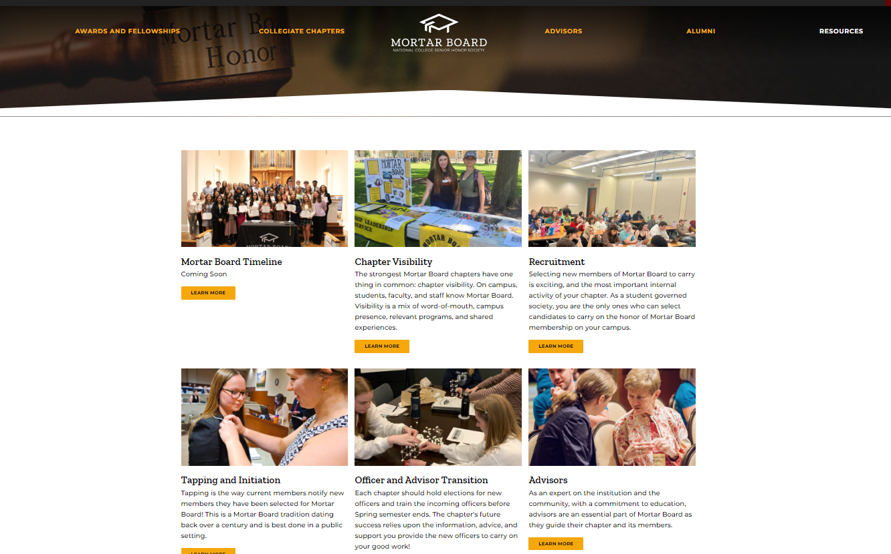
Updated Resources Webpage
Notes:
Ben

Slide 28
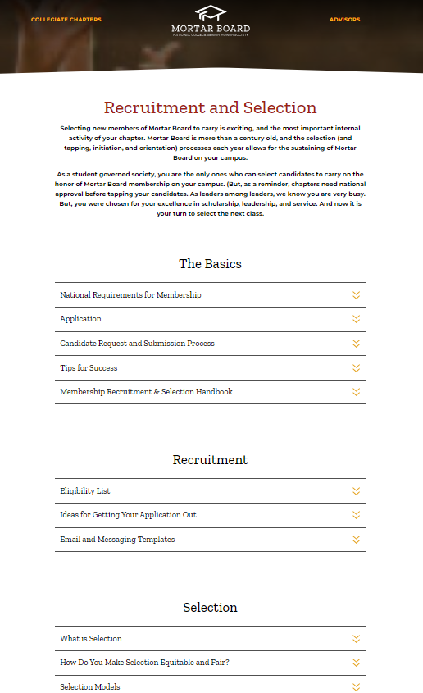
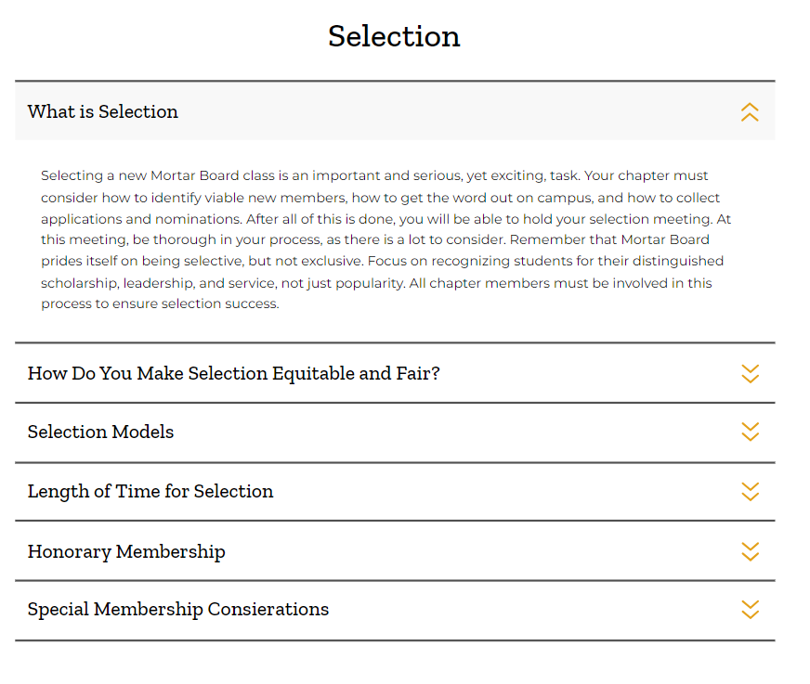
Updated Resources Webpage
Notes:
Ben

Slide 29
Mortar Board Common Application
Previously used for struggling chapters, now open to all
Chapters can add up to 5 campus-specific questions
Know your applications in real time
National Office helps manage app collection
Simplified Candidate Request process
We’ll ask you to indicate if you’re using the Mortar Board Common App on Chapter Action Plan (due September 30)
Notes:
Ben

Slide 30
2024-2025 Calendar - Important Dates
Chapter Action Plan Deadline | September 30 (Oct 15 for quarter schools)
Fall Virtual Initiation | Sunday, November 17, 2024
Special National Conference | Sunday, January 26, 2025
Mortar Board Week | Sunday, February 9 - Saturday, February 15
Spring Initiation 1 | Sunday, April 6, 2025
Spring Initiation 2 | Sunday, May 18, 2025
Chapter Annual Report & Collegiate Award Deadline | May 15 (June 1 for quarter schools)
National Conference 2025 | July 19 & 20 (virtual)

