Slide 1
Setting Up For a
Strong Year
September 2025

Slide 2
Save The Date!
Mortar Board Book Club
  September 23
Chapter Action Plans Due
  September 30
  October 15 (quarter schools)
Week of Service
  October 20-26
Fall Virtual Initiations
  October 5, November 16, December 7
Fellowship Apps Open
  November 15
Governance Recommendations Due
  December 1
Special National Conference
  January 25, 2026
Mortar Board Week
  Monday, Feb 9 – Sunday, Feb 15
Fellowship Deadline
  March 15
National Virtual Initiations
  April 19, May 17
Chapter Annual Reports & Collegiate Awards Deadline
  May 15
Governance Recommendations Due
  June 1
National Conference 2026 (Columbus)
  Friday, Sept 25 – Sunday, Sept 27

Slide 3
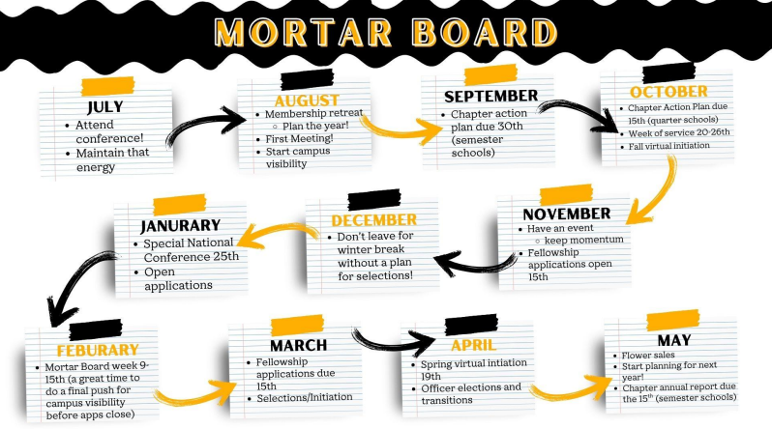

Slide 4
Semester Programming
Generally important to have a diversity of chapter events on topics including:
  Leadership development
  Group-based service activities
  Scholarship promotions
  Fundraising events
  Faculty/staff/student recognition

Slide 5
Special National Conference
Mortar Board is a student-led organization, and the SNC is a critical piece of how our governance operates and provides a venue to have student voice heard in the organization
SNC is a requirement for many chapter-based awards.
Opportunity to connect with your fellow Mortar Boards and your RC mid-year for selections planning and help if you need it!
SNC is virtual and typically around an hour and a half long - you could make it a chapter event and tune in as a group, as there is no attendance limit!

Slide 6
Mortar Board Week
Mortar Board Week is Monday, February 9th to Sunday, February 15th
  Great time for chapter visibility
  During Valentine’s week (a great time for fundraising opportunities)
Campus Visibility Ideas
  Tabling events
  Partnering other campus organizations
Fundraising Ideas
  Valentine’s candy grams
  Flowers (not Blossoms Express)

Slide 7
Selections
Selections can be overwhelming -- ask for help! Your Region Coordinators, National Office, and fellow advisors are great resources!
Think about Fall and Spring selection
  Talk with Trish and your RC what will be the best practice for your chapter
Selections can be a lengthy process START EARLY
  Your year will fly by, make sure to take actions starting IN THE FALL
  Spring break should be a hard and fast stop. Make sure to select before your campus goes out on break!

Slide 8
Selections: Optimal Timeline
Use the fall to build chapter visibility and prep materials
Send out application in January
Deadline around Mortar Board Week (Feb 9-15)
Selection late February
Tapping early March
Initiation end of March; officer elections
Officer and Chapter Transition in April

Slide 9
Officer Transitions
Elections and transitions are the most critical part of ensuring the next chapter is successful and stays active
Be involved in chapter transition so you know the new leaders and they understand how you support them
Explain the importance of attending Mortar Board National Conference and help get the next chapter president registered for conference!
Be sure to pass on accounts and passwords to the new chapter: any social media accounts, files, and bank accounts

Slide 10
DISCUSSION:
What tips do you have for a successful year?

