Slide 1
Advisor Meet-Up: State of the Society
September 27, 2024

Slide 2
Agenda
Introductions
Name
Institution
Position
How long with Mortar Board
Favorite fall food/drink
Chapter Annual Report Data
Bylaws and Membership Changes
Discussion

Slide 3
Chapter Annual Report Findings

Slide 4
Factors to Note
65 chapters submitted as of June 2
(69 submitted during 2023)
17 active chapters have not yet completed the report. They will be reminded and asked to complete by July 1.
Chapters that are struggling did not complete this report (n= 11). Nor did chapters that are being reactivated (n= 7).
It can be assumed that engagement numbers, financials, and chapter health represent a high point of comparison and will substantially decrease when chapters of concern are added.

Slide 5
What advice do you have for next year?
Better time management & planning (22)
Communication - advisors, national, others (13)
Build community (11)
Increase events and programming (11)
Increase member engagement (10)
Set meetings & events early in year (7)
Work together / delegate (7)
Start selection sooner (6)
Build off last year’s momentum (6)
Host in-person meetings (6)
Increase chapter visibility (4)

Slide 6
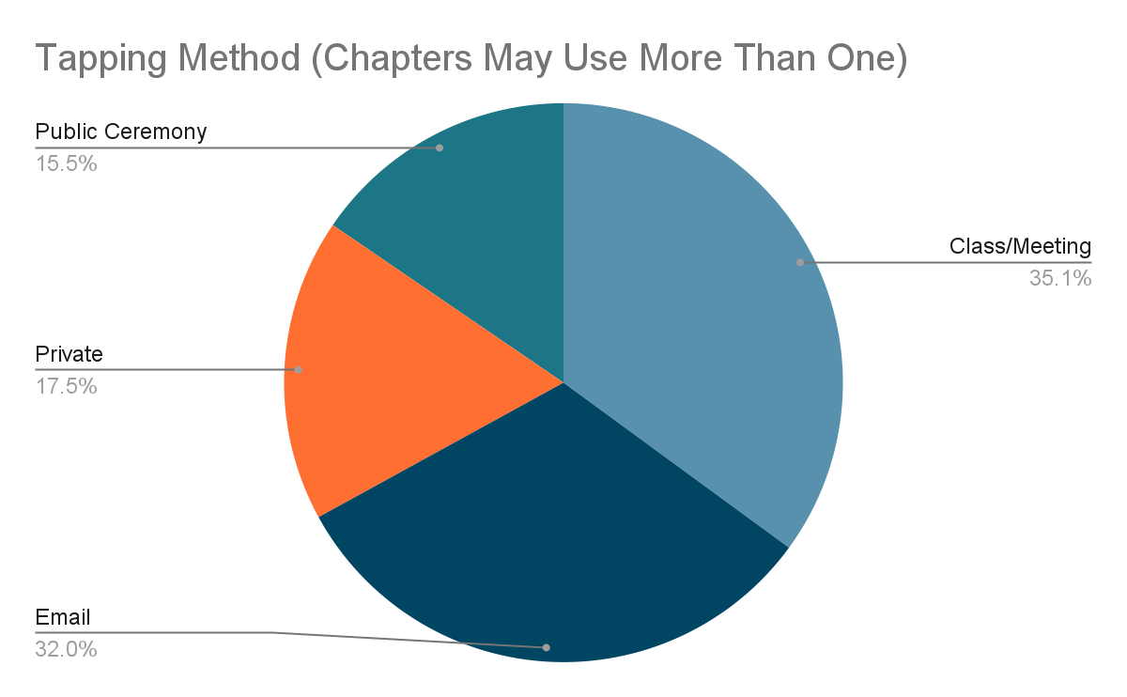
How did you tap?
34 In class/meeting
31 Email
17 Private (unspecified)
15 Public ceremony
16 tapped with email being the sole means of tapping. This EXCLUDES 12+ reactivating chapters/those facilitated by National Office.

Slide 7
What can the National Office do to better support your chapter?
Posters / social media templates
Annual calendar/timeline
More troubleshooting advice
Simpler communication
Step-by-step guidance
Easy way to reach alumni
Chapter-to-chapter collabs facilitated nationally
Change CR/OMR process (clunky)
Reach out to each chapter personally

Slide 8
Chapter Finances
How much is in your account?
Where is your bank account?
No bank account
On-campus
Off-campus
3 Both on & off-campus
Are you eligible for student government funding?
29 Yes
18 No
18 Unsure
3 | $0 / no account
12 | Less than $350
3 | Less than $500
10 | $500 - $999
18 | $1,000 - $4,999
7 | $5,000 - $9,999
6 | $10,000 +
6 | Unsure

Slide 9
Chapter Fundraisers
How many fundraisers did your chapter hold?
104 (range 1 - 20, 42 responded)
The average chapter held 2.5 fundraisers
Approximately how much did you fundraise in total?
$153,720 (range $3 - $44,413, 38 responded)
(approximately $4,045 per fundraiser*)
*This number is greatly skewed by Blossom Express chapters

Slide 10
For Starbucks gift card #1 (awarded to the closest guess): What is the total number of community service hours chapters reported completing? (60 chapters reporting)

Slide 11
For Starbucks gift card #1 (awarded to the closest guess): What is the total number of community service hours chapters reported completing? (60 chapters reporting)
11,369 hours!
(that’s 473 days… or 1 year 3½ months!)

Slide 12
Understanding Chapter Health
Membership | amount of applications, yield from candidates to paid members
Activities | holds activities around scholarship, leadership, service, campus recognition
Financial | pays national dues, holds fundraisers, has adequate funds for activities
Advisors | at least one committed advisor, advisor feels supported/trained in their role
Officers | strong executive board, e-board feels supported/trained in their role
Member Engagement | members participate in activities and meetings

Slide 13
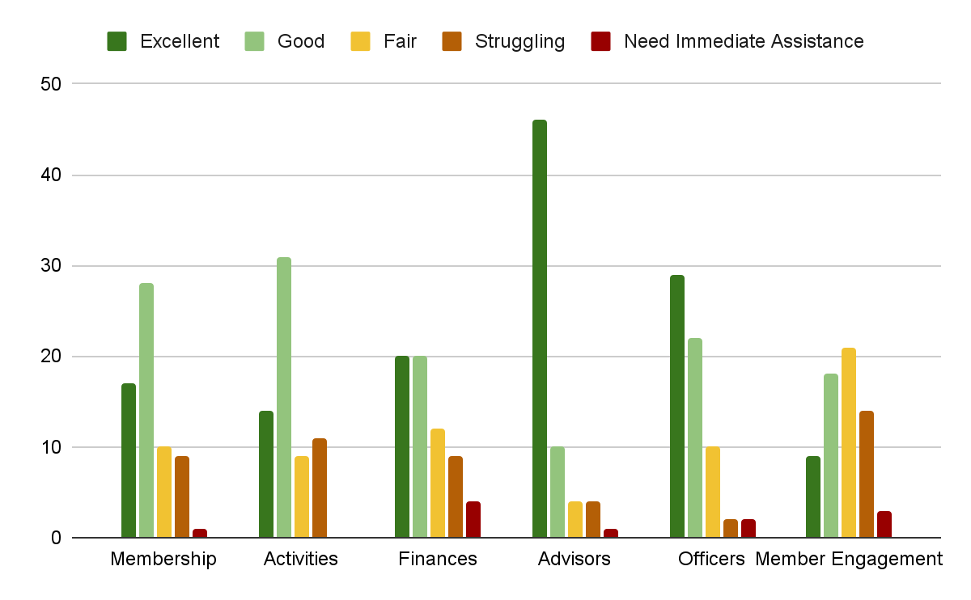
Self-Reported Chapter Health

Slide 14
For Starbucks gift card #2 (awarded to the closest guess): What percentage of your chapter would you consider active members?

Slide 15
For Starbucks gift card #2 (awarded to the closest guess): What percentage of your chapter would you consider active members?
60%
With an average chapter size of 23, that’s <14 members

Slide 16
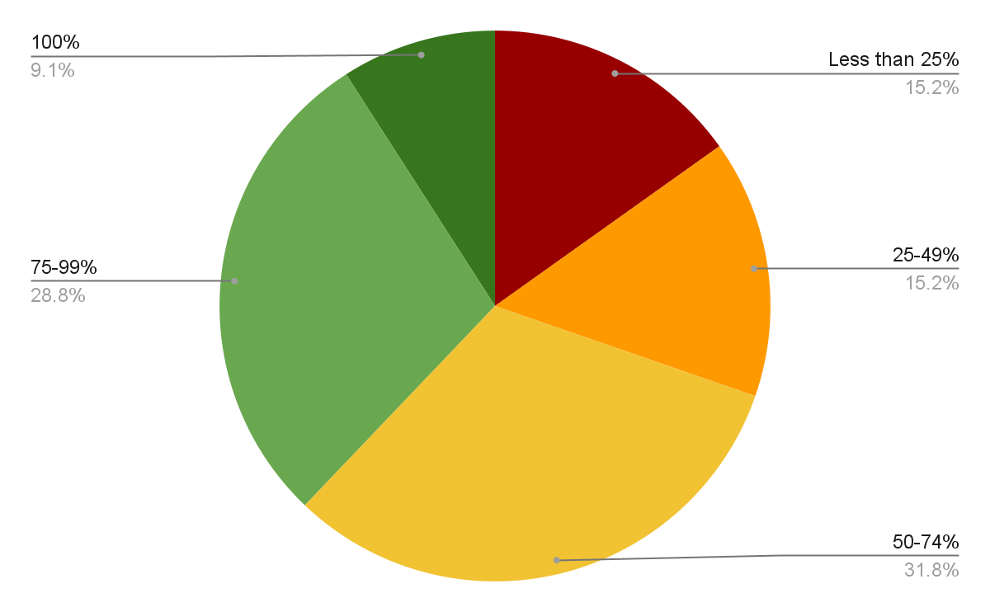
What percentage of your chapter are active members?
Less than 25% | 10
25-49% | 10
50-74% | 21
75-99% | 19
100% | 6

Slide 17
Membership Number Insights & Implications for Practice

Slide 18
Candidates vs. Members
Historically, we’ve always looked at two numbers:
Candidates = those selected for membership
Members = those who accept membership/pay dues
 | 2020 | 2021 | 2022 | 2023 | 2024
Candidates | 4240 | 4255 | 2952 | 3053 | 2672
Members | 3363 | 3098 | 2230 | 2389 | 2134
Yield | 79.3% | 72.8% | 75.5% | 78.3% | 79.9%

Slide 19
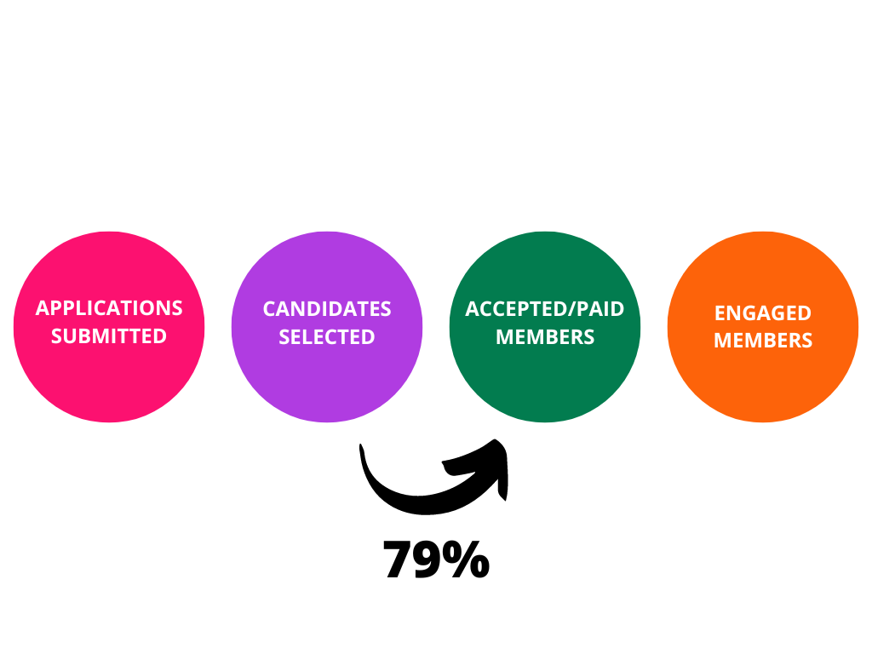
Widening the Scope

Slide 20
Widening the Scope

Slide 21
Looking Beyond Membership Numbers
Total number of applications reported:
4,585
1,930 interested enough to apply, but not selected
Application-to-Candidate yield:
57.91%
Candidate-to-Member
Yield:
79.9%

Slide 22
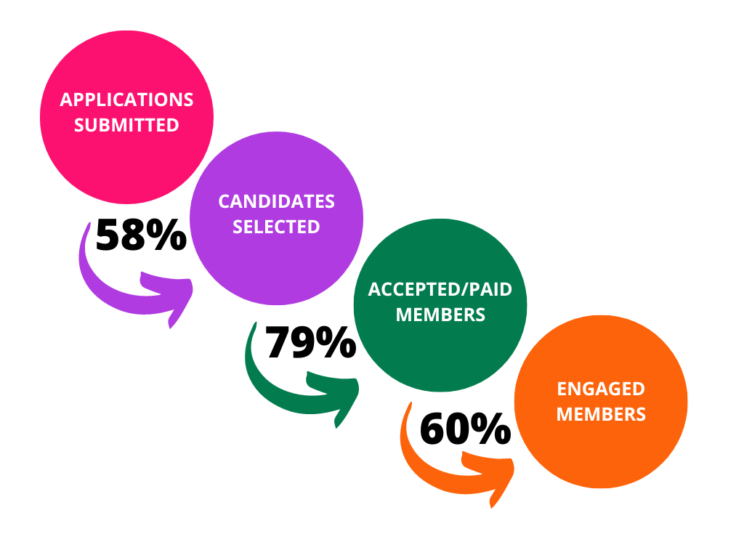
Breaking Down the Numbers

Slide 23
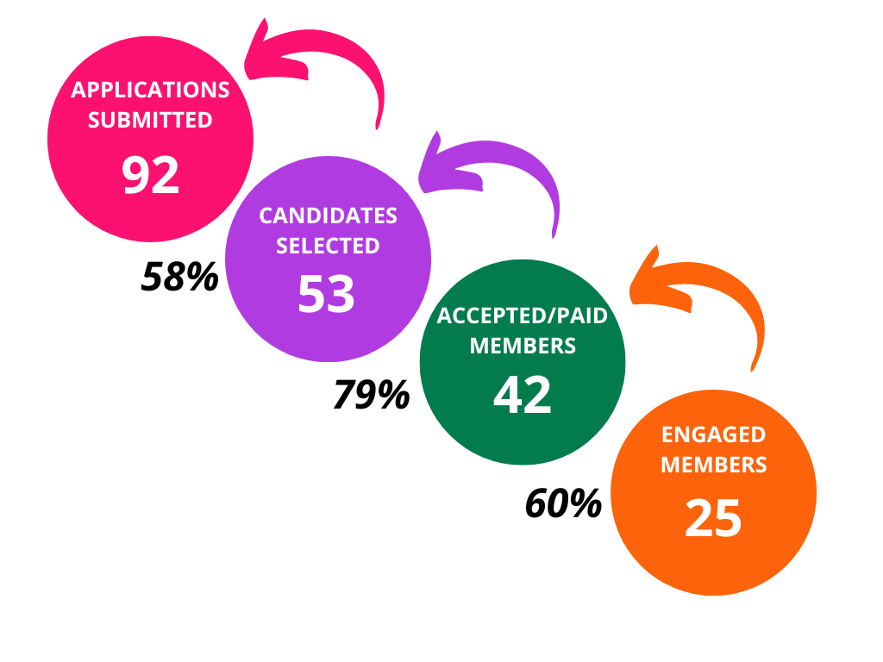
Breaking Down the Numbers
27.2%

Slide 24
Things to Consider:
How many quality applications is your chapter getting?
Do you have too many or not enough?
How many members are actively engaged?
How do you increase engagement?
What’s your chapter’s “math” for membership?

Slide 25
Bylaws & Membership Changes

Slide 26
Student Voice and Votes
At the National Conference in July 2024, collegiate delegates came together to discuss and vote on a new membership structure first proposed by an ad-hoc Membership Committee and brought forward to the collegiate delegation by the Governance Committee.
The resulting votes will change the landscape of Mortar Board, but a change that the membership committee, Governance Committee, National Leadership, and today’s collegiate members, feel is imperative to the success, growth, and sustainability of the Society in our second century.

Slide 27
Accepted Amendments
Action Proposed: Change the eligibility for Mortar Board membership to be a more inclusive collegiate membership through the following:
The addition of juniors to Mortar Board National College Senior Honor Society. Students in their sophomore year (or the equivalent status in units or hours) and/or undergraduates who will have completed 50% or more of credits needed for graduation at the end of the term in which they are selected, would be eligible for membership.
The addition of graduating seniors, not to exceed 25% of the incoming class. Students are eligible to be selected for membership in their final term of college prior to graduation as long as the total number does not exceed 25% of the new initiates.
The addition of a statement on financial equity and accessible membership. Financial limitations should not be a barrier for membership. Collegiate members would only pay for membership upon entry, despite their length of time as an active collegiate member (i.e., one year vs. two years).

Slide 28
What does this mean?
Mortar Board will drop "senior" from the official name and now be known as Mortar Board National College Honor Society.
Mortar Board chapters have the option to have members participate as either/both juniors and seniors in college.
The Mortar Board collegiate experience may be a two-year experience for many members.
It is NOT a requirement for chapters, select rising juniors, it is only an expansion of eligibility.
Any chapter who chooses to select rising juniors must also continue to make the opportunity available to current and rising seniors.
Interested and eligible collegiate members receive the benefit of more than one year of participation, gaining continued experience in the areas of leadership, service, advancing scholarship, and connections with other Mortar Board members.
Multi-year participation also helps grow and sustain chapters from one year to the next as it both increases the number of eligible students while returning students bring knowledge and experience to the chapter.

Slide 29
What does this mean?
Students are eligible to apply for membership starting any term after they have completed 50% of credits needed for graduation (inclusive of 3+2 programs, 5-year programs, transfer from community college, etc.)
If a student is not selected the first time they apply, they are eligible to reapply in subsequent selection cycles, pending they still meet the academic requirements and have not yet graduated.
Students can be selected for membership in their final term (i.e. final quarter or semester) as long as the number of graduating/final term students does not exceed 25% of the total selected students.
In other words, at least 75% of a selected candidate class must have at least one full semester remaining beyond the term in which they are selected.
In Mortar Board's commitment to continued equity, access, and inclusion, it is to be noted in the recruitment and selection process that financial limitations are not a barrier for membership and gift memberships and other opportunities are available.

Slide 30
Accepted Amendments
Action Proposed: Increase opportunities for chapter leadership with elected officer positions.
Strike current bylaw that states that only single office holders may be elected, not allowing for co-officers.
Strike current bylaw that states that any member only present for one semester (i.e., graduating early, off-campus for an internship, or studying abroad) is ineligible to serve in an elected leadership role.

Slide 31
What does this mean?
Chapters can choose to elect co-officers to any leadership position.
Chapters can choose to allow students to serve in a leadership role even if that elected person is only available to serve for one semester.

Slide 32
Accepted Amendments
Action Proposed: Replace Mortar Board Alumni Association with Mortar Board Alumni and add a statement that all Mortar Board collegiate members become Alumni upon graduation.
Mortar Board has always promoted Society membership as an opportunity to experience lifelong engagement. Offering programmatic and outreach initiatives to a segmented MBAA annual population dilutes our ability to engage all members. This change will instead focus on increasing opportunities for engagement with all alumni.

Slide 33
What does this mean?
All Mortar Board collegiate members become Alumni upon graduation without any additional fees or dues.
All Mortar Board alumni are eligible for the same member benefits including:
Access to Mortar Board events and engagement opportunities
National volunteer and leadership opportunities
Opportunity to apply for graduate level Fellowships
Recognition by Mortar Board
Alumni support and connection to over 50,000 active alumni worldwide
Federal jobs pay increase
Access and discounts to Mortar Board partner-sponsored products

Slide 34
Membership Fee Changes

Slide 35
Member Types and Corresponding Dues
Collegiate Membership Dues
$80 per new member
Continuing Senior Dues
$40 per continuing senior/student
Mortar Board Alumni Association Dues
$45 for an annual MBAA membership
$600 for a Lifetime Membership

Slide 36
2025 Membership Dues
Collegiate Membership Dues
$100 per new member
Continuing Senior Dues
$0
This fee has been eliminated
Mortar Board Alumni Association Annual Dues
$0
This fee has been eliminated
Mortar Board Lifetime membership will continue
Under a new name/brand

Slide 37
Why the dues increase?
Our last dues increase was January 2014.
According to the Bureau of Labor Statistic and the Consumer Price Index (CPI) the buying power of $80 in 2014 is now worth $108.95 today, that’s more than a 35% increase.
We are simultaneously eliminating continuing senior / continuing student dues as well as alumni annual dues. Membership dues are a one-time payment with the benefit of a lifetime membership.
Our collegiate dues are equivalent to the dues amount for other "like" honor societies (ODK, NSCS, Phi Beta Kappa).
Mortar Board is committed to opportunities for access and has gift memberships available for students needing financial assistance. Financial limitations should never be a barrier for membership.

Slide 38
Discussion ☺

